Slide 1
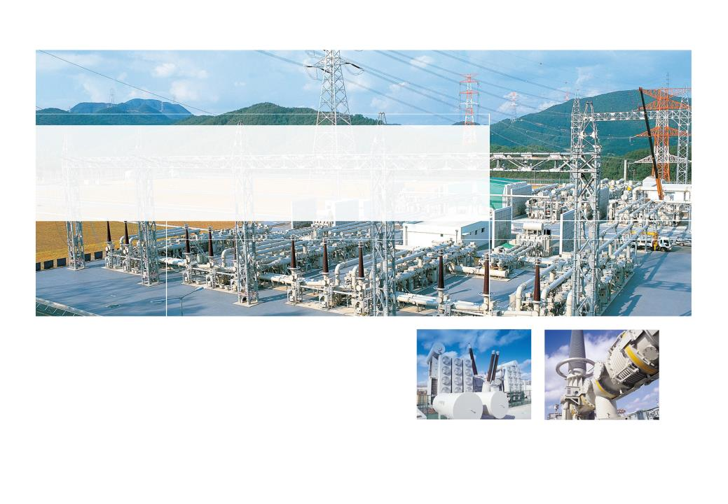

YaWei Power Transformer
Site Installation & Maintenance Training
亚威变压器现场安装&维护培训
Power Systems PU
Project II Team Rev.0 (Mar. 2014)

Slide 2
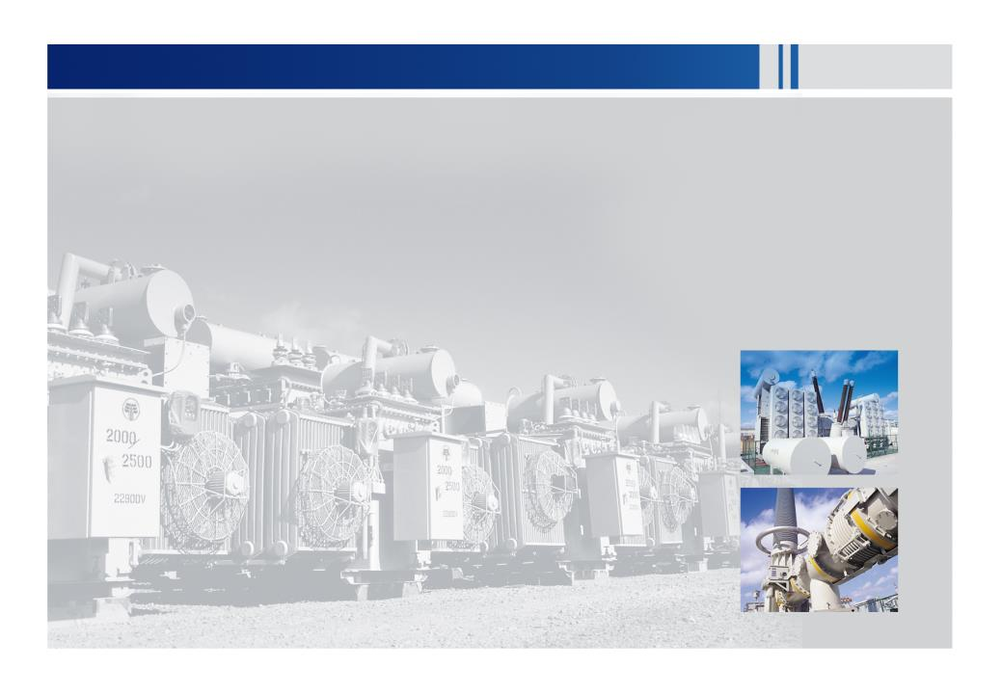
Contents目录
Transportation运输
1.1. From port to Site Foundation港口至地基
2. Site Installation 现场安装
2.1. Transformer Installation Flow Chart变压器安装流程图
2.2. Supervision Inspection Points during Installation安装中监理检查点
2.3. Inspection接受检查
2.4. Preparing 准备工作
2.5. External Assembly外部安装
2.6. Internal Connection内部连接
2.7. Torque力矩
2.8. Vacuuming 抽真空
2.9. Oil Preheating and Oil Circulation油预热&油循环
2.10. Insulation Strength Test绝缘强度测试
2.11. Vacuum Oiling真空注油
2.12. Adjusting Oil Level调节油位
2.13. Oil Circulation油循环
2.14. Site Test (According to STP)现场试验（根据现场试验计划)
3. Protective Relays保护性继电器
4. Maintenance维护

Slide 3

1. Transportation运输

Slide 4
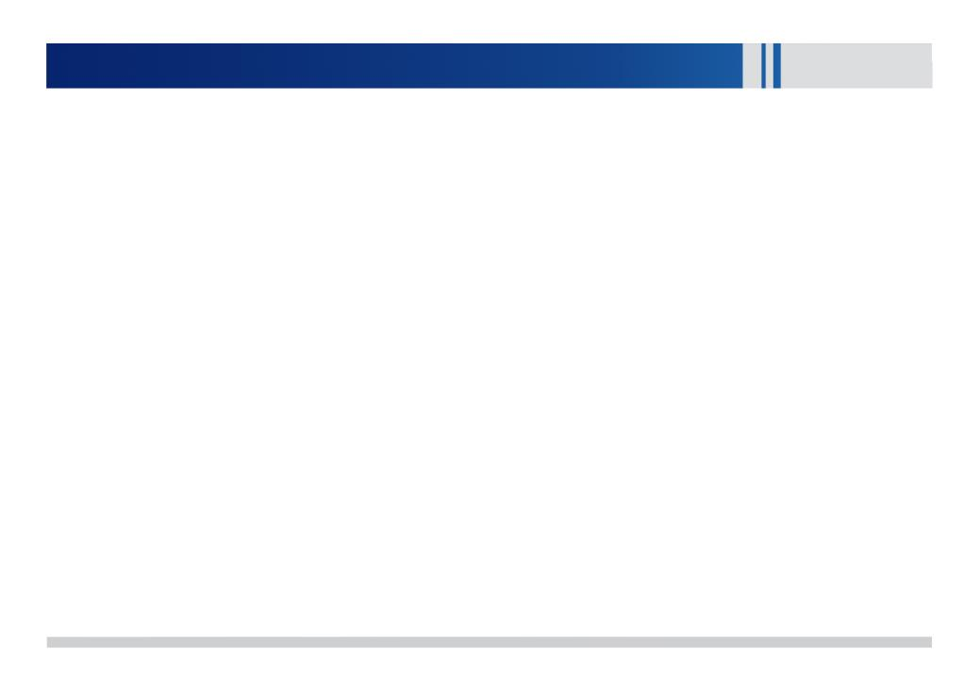
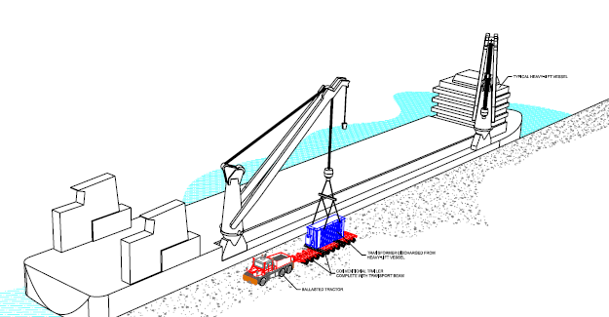
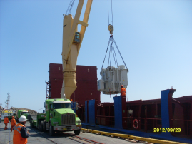
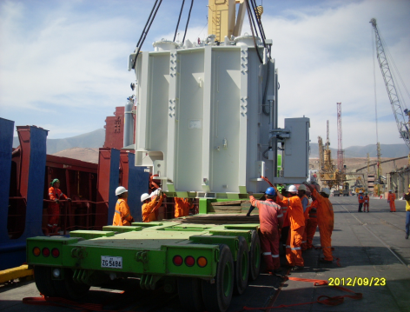
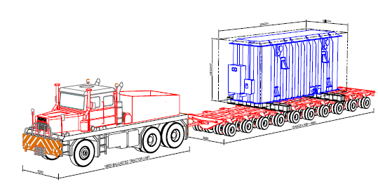
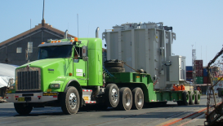
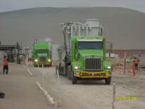
From Port To Site Foundation港口至地基
Transformer Active Part Unloading
变压器主体卸载
Transport to site.运输至现场
·
Global Top Energy Solution Provider

Slide 5
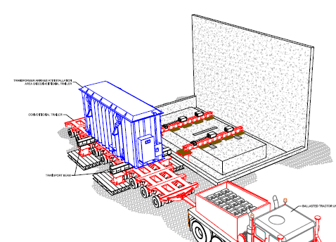
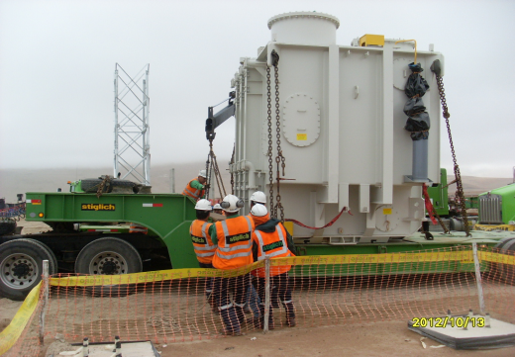
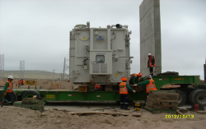
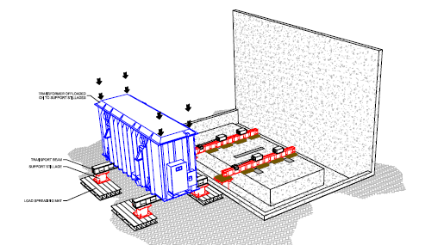
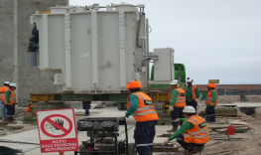
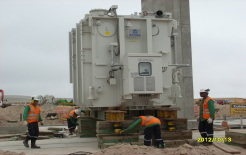
From Port To Foundation港口至地基
Unloading Active Part beside
Foundation.地基旁卸载主体
Prepare to Move Active Part to
Foundation准备将主体移至地基上
·
Global Top Energy Solution Provider

Slide 6
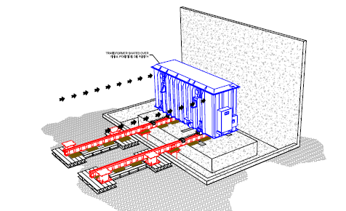
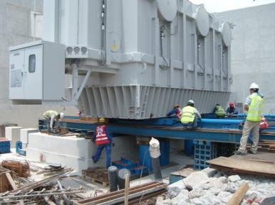
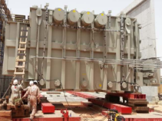
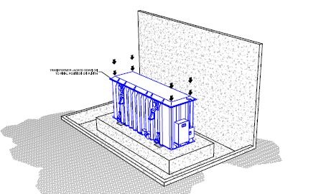
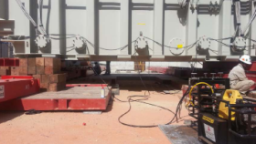
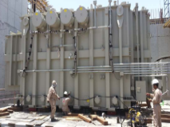
From Port To Foundation港口至地基
Move Active Part to the Foundation将主体移至地基上
Installed on the Foundation
放在地基上
·
Global Top Energy Solution Provider

Slide 7
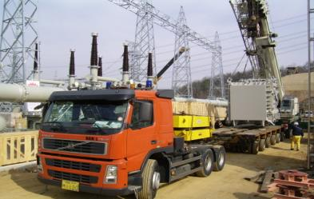
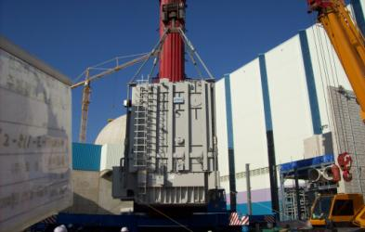
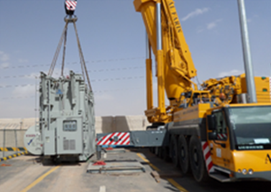
From Port to Foundation（Using a Crane)港口至地基（使用吊车）
If possible, active part can be placed
by using a crane
如果有可能，使用吊车放置主体
·
Global Top Energy Solution Provider

Slide 8
1. Site Installation现场安装

Slide 9

Transformer Installation Flow Chart变压器安装流程图
Visual inspection of the active part and parts目测主体及部件
Internal pressure, three-dimensional impactor, dew point, iron
core megohmmeter 内部气压，三维冲撞仪，露点，铁芯兆欧表
Visual Inspection目测
Manpower : At least 10 Workers 人力：至少10名员工
Instruments set up : Dry air, Tools, Crane, Manlift, etc.
设备：干燥空气，工具，吊车，升降机等
Checked Power Supplier : 3P 380/440V, 200kW
Preparing 准备工作
Bushing Test套管测试
C1&C2 test before installing bushing (If Required)
安装套管前进行C1&C2测试
Insulation Resistance Test 绝缘电阻测试
Parts Assembly部件安装
Radiators, Conservators, Arresters, Bushings, etc 散热器，油枕，避雷器，套管等
Insulation resistance, ratio, polarity (in case the CT lifting seat is not installed on the active part during transportation)) 绝缘电阻，变比，极性（以防CT升高座运输时没有安装到主体上）
CT test before vacuum
真空前CT测试
Tighten the connection between the bottom of the sleeve and the coil lead again 再次紧固套管底部和线圈引线连接
visual inspection 目测
Internal Lead Connection
内部引线连接
Confirm the vacuum pressure and maintenance time according to the technical manual 根据技术手册确认真空压强、维持时间
If it is below 10 ℃, iron core, coil, and oil circulation need to be carried out 如果低于10℃，需进行铁芯，线圈和油循环
Vacuuming and Filling
抽真空注油
Site testing现场测试
Megger, Voltage ratio, BCT polarity.
兆欧表，电压变比，套管电流互感器极性
Bushings, Arresters, Winding resistance, Relays, etc.套管、避雷器、绕组电阻，继电器，等等
Global Top Energy Solution Provider

Slide 10
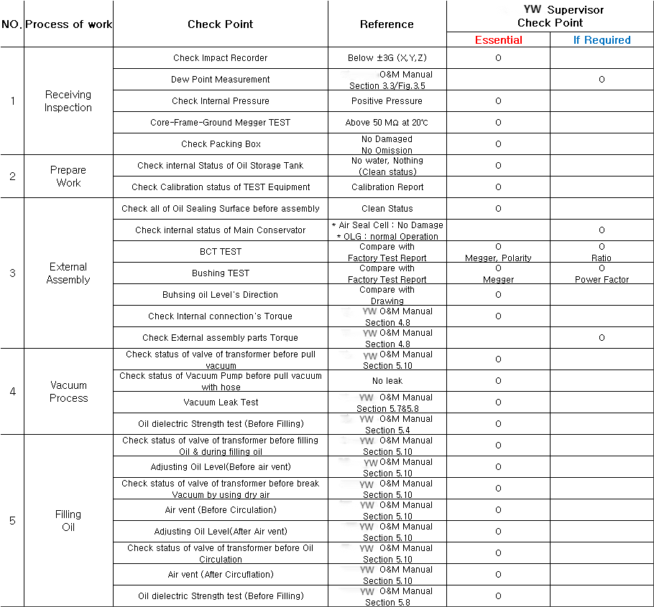
Supervision Inspection Points during Installation安装中监理检查点
Global Top Energy Solution Provider

Slide 11
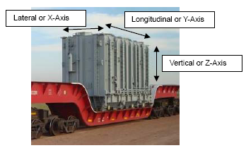
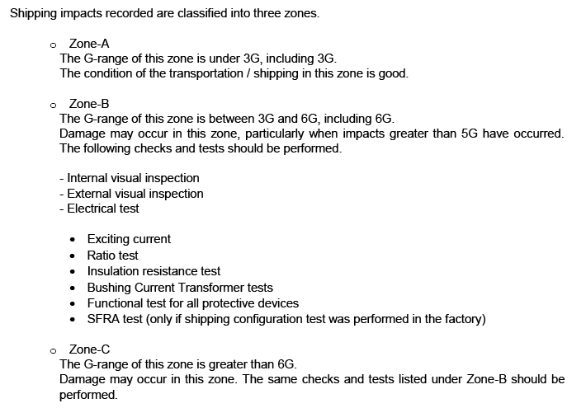

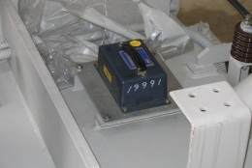
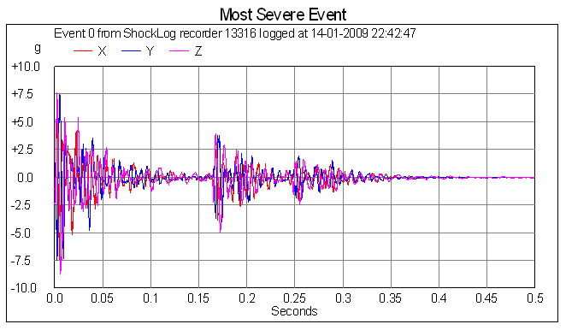
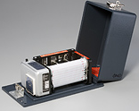
Inspection (Collision Recorder)接受检查（冲撞记录仪）
Impacts | Deflection from Center in Number of Grids
 | X | Y | Z
3G | 1.8 | 2.1 | 2.3
6G | 3.8 | 4.5 | 4.9
Global Top Energy Solution Provider

Slide 12
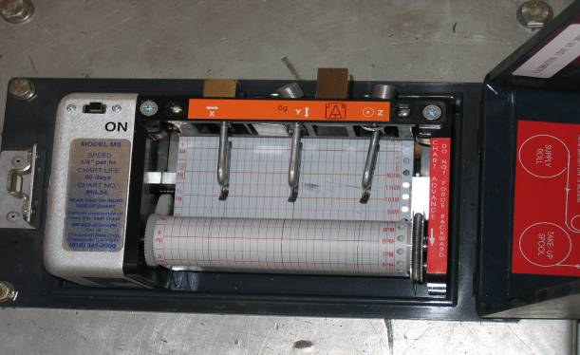
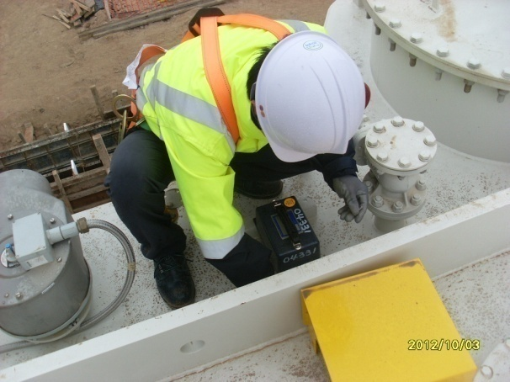
Inspection (Collision Recorder)接受检查（冲撞记录仪）
Horizontal横向
Longitudinal纵向
Vertical垂直方向
· 3D Collider Checkpoints
三维冲撞仪检查点
- Longitudinal : Below ±3.0G
纵向：低于±3.0G
- Vertical : Below ±3.0G
垂直方向：低于±3.0G
- Horizontal: Below ± 3.0G
横向：低于±3.0G
* G : Gravity
G：代表重心
Analog型号
Global Top Energy Solution Provider

Slide 13



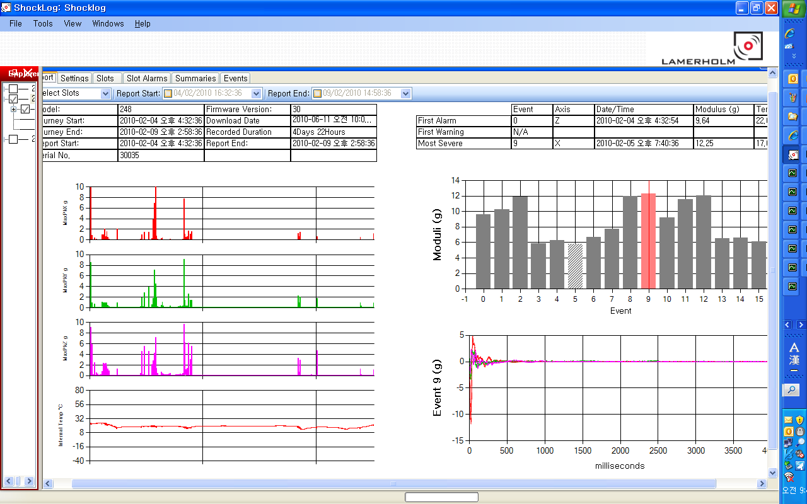
Inspection (Collision Recorder)接受检查（三维冲撞仪）
Digital Type
数字型号
Global Top Energy Solution Provider

Slide 14
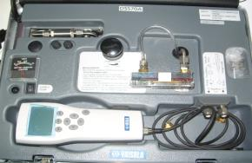
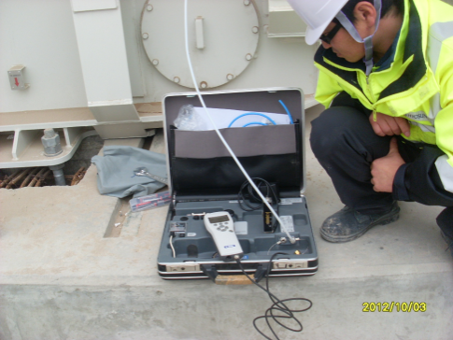
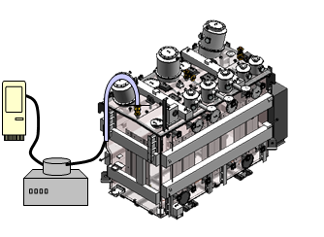
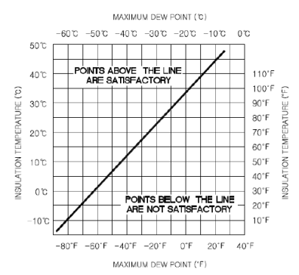
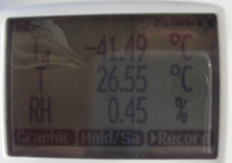
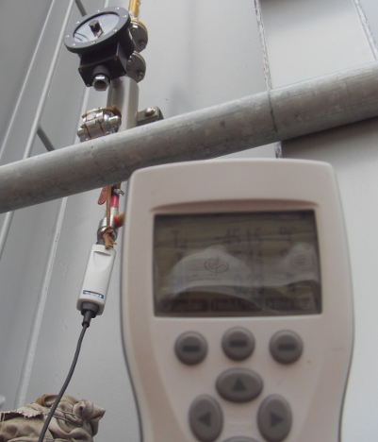
Inspection [Dew Point Measurement( IF Required)]接受检查(露点测试，如需要）
DEWPOINT TEST露点测试
Measure internal tank temperature and measure the Dew Point temperature of the air inside the tank.
测量油箱内部温度和箱内空气露点温度
Use Figure 3.5 for pressure between 0 and 5 PSI
Use upper and left axes for temperatures recorded in Celsius, use the lower and right axes for temperatures
recorded in Fahrenheit.上轴和左轴用摄氏温度记录,下轴和右轴用华氏温度记录
Figure 3.5图3.5
Global Top Energy Solution Provider

Slide 15
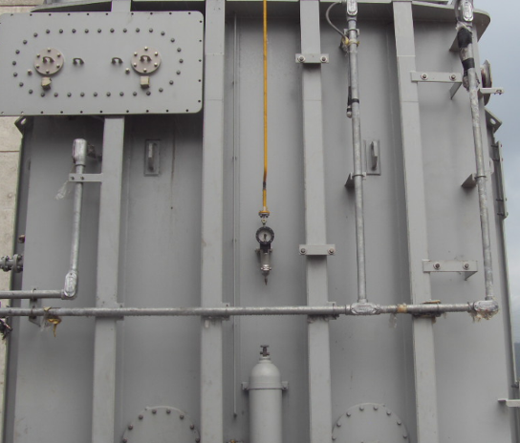
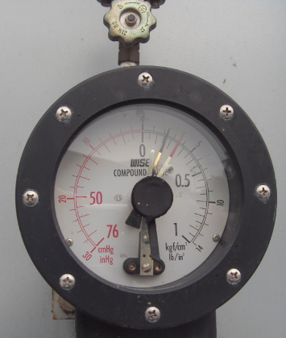
Inspection (Check Internal Pressure)接受检查（检查内部气压）
Positive Pressure正压
OK
Global Top Energy Solution Provider

Slide 16
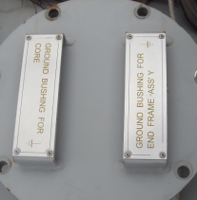
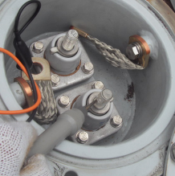

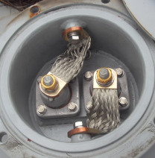
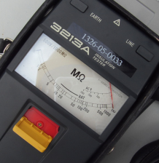
Inspection (Measure Insulation Resistance )接受检查（测量绝缘电阻）
Insulation Resistance Check绝缘电阻检查
Measure Insulation Resistance between Core-Frame-Ground.测量铁芯-夹件-接地的绝缘电阻
Global Top Energy Solution Provider

Slide 17
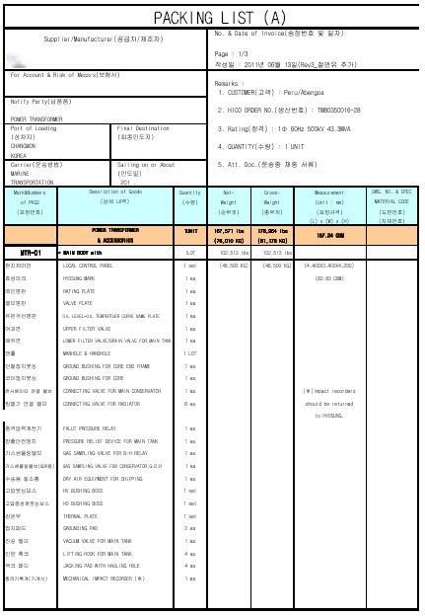
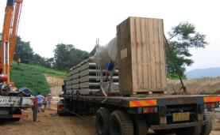
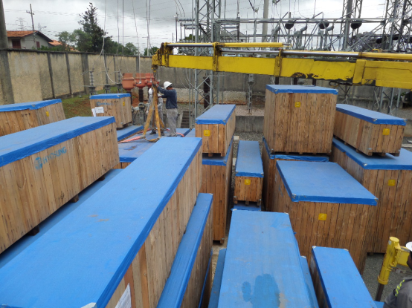
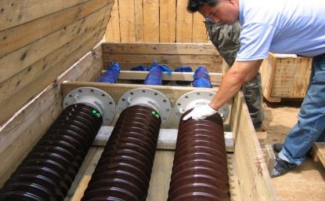
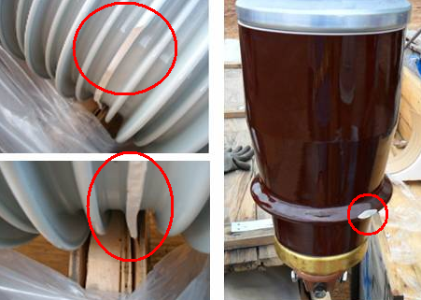
Inspection ( Check Wooden Case & Accessory )接受检查（检查木箱及附件）
· Check all wooden case for external damage.
检查所有木箱是否外部损坏
· Open each wooden box and confirm if the contents of the packing list are consistent 打开每个木箱，确认装箱单的内容是否一致
· Check for component damage
检查是否有部件损坏
· Store under fire, moisture, and anti-theft safety conditions在防火、防潮湿、防盗安全情况下存储
Global Top Energy Solution Provider

Slide 18













Prepare Work准备工作
Oil filter (with oil pipe) 滤油机（附带油管）
- 6000L/hour [RVP : 3750L/min, MBP : 1500m3/hour]雷德蒸汽压
Vacuum oil pump (with oil pipe and vacuum chamber)真空油泵（附带油管&真空室）
- [RVP : 3750L/min, MBP : 1500m3/hour]
Vacuum gage(Up to 0.01Torr), Oil dielectric Tester(0~75kV), Hygrometer(0~100%)
真空表（达到0.01托），绝缘油测试仪(0~75kV），温度计(0~100%）
Manometer(-76mmHg~1.0kgf/Cm2), Dew point tester(-100C~30C)
压力计(-76mmHg~1.0kgf/Cm2), 露点仪(-100C~30C)
- Check Calibration status检查校验状况
Hydraulic Crane(5~50 ton), Oil storage Tank (20,000L), Compressor (5kg/Cm2)
液压起重机(5~50吨），储油罐(20,000L), 压缩机(5kg/Cm2)
Man lift(if required), Dry air (> -55C , with hose& Fitting)
升降机（如果需要），干燥空气(> -55C , 带管& 装配)
- Check Internal Status of Oil Storage Tank检查储油罐内部情况
Spanner, Rachet Wrench, Box spanner, pipe wrench, Adjustable angle wrench
-> 10,11,13,14,17,19,22,24,27,30,32,36,42,46 mm
螺丝扳手，活动扳手，套筒扳手，管钳，活络扳手
Insulation Resistance Tester, Multi-meter, BCT tester (or Galvano meter)
Check Calibration Status
绝缘电阻测试仪，万用表，BCT测试仪
检查校验状况
( According to Site Test Plan )根据现场测试计划
Power Factor Tester, Winding Resistance Tester, SFRA TESTER ,,,,,etc.
Check Calibration Status
功率指数测试仪，绕线电阻测试仪,扫频响应分析
检查校验状况
Ladder, rag, alcohol, Individual safety equipment,, fitting for connection ,,,,,etc.
梯子，抹布，酒精，个人安全设备，连接装配等
Global Top Energy Solution Provider

Slide 19






External Assembly外部安装
< Manifold & Bracket Assembly >
集油管道&支架安装
1) To assemble radiator, manifolds has to be
assembled in advance.
安装散热器前先安装集油管道
2) Brackets for external accessory also has to be
assembled in advance.
外部附件支架需提前安装。
Surface of manifold’s flange for mounting has to be clean to prevent oil leakage
集油管道法兰表面需清理干净以防漏油
Global Top Energy Solution Provider

Slide 20






External Assembly外部安装
< Radiator Assembly>散热器安装
Before assemble radiator, Check Valve Status
安装散热器之前，检查阀门
2) Assemble radiator carefully仔细安装散热器
Because radiator is easy to be broken during lifting, operator of crane has to be experienced person.
吊运中散热器易损坏，开吊车的必须是专业人员
Surface of radiator’s flange for mounting has to be clean to prevent oil leakage
散热器法兰表面表面需清理干净以防漏油
Global Top Energy Solution Provider

Slide 21





External Assembly外部安装
< Conservator Assembly >油枕安装
1) Before assembling conservator, it need to
be tested. 安装油枕前，先检查油枕
- Oil Level Gage float condition check
检查油位计漂浮状况（检查外观）
( Check its external appearance)
- Oil Level Gage Operation test
油位计操作测试
- Air Seal Cell Pressure test
空气密封室压力测试
(0.1kgf/Cm2, hold 1hour or more)
2) After check inside, assemble conservator
内部检查之后，安装油枕
Global Top Energy Solution Provider

Slide 22






External Assembly外部安装
< Bushing Turret Assembly >套管安装
Before assembling bushings, CT need to be tested.
套管安装前，检查CT
- CT Ratio, Polarity Test
CT变比，极性测试
- CT Insulation Resistance Test
CT绝缘电阻测试
- Check CT’s external appearance
检查CT外观
The weather condition during turret assembly has to be sunny day.
And must be caution to let things fall
需晴天安装套管，小心有物体落入
Global Top Energy Solution Provider

Slide 23






External Assembly外部安装
< Bushing Assembly >套管安装
1) Before assembling bushing, it need to be
tested. 安装套管前，先进行测试
- Check Bushing’s external appearance
检查套管外观
- Insulation Resistance Test
绝缘电阻测试
- Power Factor Test(If required)
功率测试（如需要）
- Check Bushing’s external appearance
检查套管外观
In general, direction of bushing oil level
gauge is as shown below
(But always review the bushing
manufacturer’s manual and transformer’s
drawing to determine how the bushings
should be oriented)
套管的油位计方向如左图所示(参考套管厂 家手册和变压器图纸来决定怎么定位套管）
Global Top Energy Solution Provider

Slide 24
External Assembly外部安装
< Bushing Handling >套管处理
Lift the bushing out of the wooden box and use two clean slings to lift it out
从木箱中吊出套管，用两个干净的吊索吊出
**Lift the bushing in a vertical direction and lift it to the corresponding angle according to the diagram below. Place grass mats at the bottom of the bushing during lifting
将套管吊至垂直方向，根据下图吊至对应的角度。吊运时，在套管底部放置草垫
Refer to HICO O&M Manual Section 4.13 (Rev 5)
参考HICO操作维护手册4.13部分
Global Top Energy Solution Provider

Slide 25




External Assembly外部安装
< Gas Pipe and the other accessory Assembly >
气体管道及其它附件安装
1) Assemble Gas Pipe, Protective relays, Copper
pipe, Sampling device, Ground cable, Surge
arrestor，etc
安装气体管道，保护性继电器，铜管，取样器，接地管道，避雷器
When installing gas pipelines, do not install them under forced conditions
安装气体管道时，切勿在强制状态下安装
Global Top Energy Solution Provider

Slide 26





Internal Lead Connection内部引线连接
< Bottom connection & Internal Inspection >
底部连接和外部检查
Check the number and type of tools brought.
检查带来的工具数量和型号
2) Connect the winding lead to bushing conductor.
-> Bottom connection, Draw lead, Draw rod Type
线圈引线连接到套管导电板
3) Check insulation conditions and connections.
检查绝缘条件和连接处
Before internal work, check Oxygen content over
19.5%.
内部工作之前，检查氧气含量是否超过19.5%
When connect winding lead with bottom of bushing,
Use Torque Wrench.
使用力矩扳手进行套管底部线圈引线连接
Bottom Connection Type
底部连接方式
Draw Lead Type
抽引线方式
Global Top Energy Solution Provider

Slide 27


Torque力矩
< bolts/nut Torque >螺栓/螺母力矩
Internal Connections Only
Refer to HICO O&M Manual Section 4.8
仅内部连接（参考HICO安装手册4.8部分）
This table applies to galvanized steel, SAE grade 5 and stainless steel type 304 nut an bolts through an un-threaded hole in steel, stainless steel, Copper or Aluminum base material
Refer to HICO O&M Manual Section 4.8
此表格应用于镀锌钢， SAE 5级和不锈钢304螺母螺栓穿过不带螺纹的钢铁，不锈钢，铜或铝底座的孔
（参考HICO安装手册4.8部分）
Global Top Energy Solution Provider

Slide 28



Vacuum Process抽真空程序
< Vacuum Work >抽真空
1) Vacuum oil pump maintenance includes hoses, assembly, and vacuum oil tank (no oil leakage)
真空油泵维护包括软管，装配及真空油箱（无渗油）
2) Vacuum and maintain vacuum according to instructions
按说明抽真空&维持真空
3) After required vacuum Level reached, perform
Vacuum Leak Test
达到要求的真空水平后，进行真空泄漏测试
4) All equipment must be grounded
所有设备必须接地
5) Keep monitoring to prevent vacuum leakage
-> Record vacuum value every 1hour.
持续监控以防真空泄漏
Under vacuum, No work on the
transformer is permitted.抽真空时，禁止变压器任何工作
During vacuum, it need to check leakage
of hose by separating it with transformer.
抽真空时，软管分离检查是否泄漏
Vacuum
pump
Global Top Energy Solution Provider

Slide 29

Vacuum Process抽真空程序
< Vacuum Leak Test >
真空泄漏试验
1) After reaching the vacuum level, close the valve between the vacuum oil pump and the transformer 达到真空水平后，关闭真空油泵和变压器之间的阀门
Refer to HICO O&M Manual Section 5.7 (Rev 5)
参考HICO手册5.7 部分
Vacuum
pump
Valve Close
阀门关闭
2. Keep 10 Min
保持10分钟
3. Check Torr Rise
检查真空压强是否上升
Global Top Energy Solution Provider

Slide 30



Oil Pre heating and Circulation油预热及循环
< Oil Pre-heating and Circulation >
油预热及循环
Move Oil from drum to Oil tank
把油从油桶移至油箱
2) Before oil filling, conduct oil preheating and oil circulation in Storage tank to remove water and reduce oil filling time
在注油前，在储油罐内进行油预热、油循环，
目的是为了除去水分减少注油时间
Before moving oil from drum to oil tank, clean
water and dust on the drum.
油从油桶移至油箱之前，清理油桶的水和灰尘
1
OIL Drum
Oil
Purifier
2
OIL Tank
Global Top Energy Solution Provider

Slide 31



Insulation Oil Strength Test before Oil Injection注油前绝缘油强度测试
Before oil injection, insulation oil strength testing is required
according to international standards
在注油之前，根据国际标准需进行绝缘油强度测试
Global Top Energy Solution Provider

Slide 32



Vacuum oiling (process parameters)真空注油（工艺参数）
< Vacuum oiling >
真空注油
1) The maintenance of the oil filter includes: filters, hoses, accessories, and oil tanks 滤油机维护包括：过滤器、软管、配件、油箱
2) Check the oil quality before oil injection
-> Check and confirm the oil medium test accordi ng to the HICO manual
注油前检查油质
按照HICO手册检查确认油介质测试
3) Fill the oil according to the instructions in the table
按照表中说明注油
4) If the temperature is below 10 ℃, the active part needs to be preheated first
如果温度低于10℃，器身需先预热
-> Refer to HICO O&M Manual section 5.6 & 5.10
(Rev 5)
参考HICO手册5.6 & 5.10部分
Close this valve when Oil level reaches 100mm below of top of main part
油位达到主体顶端100mm之下，阀门关闭
Vacuum
pump真空油泵
OIL
Purifier
OIL Tank油箱
Global Top Energy Solution Provider

Slide 33



Adjusting Oil Level 调整油位
< Adjusting Oil Level >调整油位
1) Fill oil to scale 4 first and then stop.
先注油至刻度4然后停止
2) Then break vacuum slowly by using dry air.
然后用干燥的空气慢慢打破真空。
3) Top exhaust of oil conservator.
(Include OLTC)油枕顶部排气（包括开关）
4) During breaking vacuum, Oil level will come
down. So It need to fill more oil into Tr after
air vent work.在打破真空的过程中，油位会出现
向下因此需要在之后向Tr中注入更多的油
通风口工作。
-> Refer to HICO O&M Manual section 5.10
参考HICO操作维护手册 5.10 部分
Vacuum
pump真空油泵
OIL
Purifier
OIL Tank
Global Top Energy Solution Provider

Slide 34

Oil Circulation油循环
< Hot oil Circulation >热油循环
1) After oil injection, perform hot oil circulation according to the table below
注油后，根据下表进行热油循环
2) After all procedures are completed, conduct the Dielectric strength test of insulating oil according to the following table 所有程序结束后，根据下表进行绝缘油介电强度测试
(If result is no good, perform hot oil circulation
more times)（如果结果不理想，多次进行热油循环）
-> Refer to HICO O&M Manual section 5.8 & 5.10 (Rev 5)
参考HICO操作维护手册5.8 & 5.10 部分
OIL
Purifier
Global Top Energy Solution Provider

Slide 35




Site Test现场测试
< Site Test > 现场测试
Inspection接受检查
- SFRA, Dew point (if required)
SFRA, 露点测试（如需要））
- Collision record. Insulation resistance(C-F-G)
冲撞记录，绝缘电阻
Wiring & Terminal Check of Protection (BCT, Neutral CT and associated accessory terminal)
接线&端子保护检查（套管电流互感器，中性点CT，相关附件端子）
Insulation resistance test (Hv -Xv- G)
绝缘电阻测试
Voltage ratio / Phase relation
电压变比/相相关
Winding Resistance绕组电阻
Power Factor功率因数
PD measurement(If required)局放测试（如需要）
Oil Breakdown Test油击穿电压试验
Functional Test性能测试
OLTC Test开关测试
Sequence Test
* According to Site Test Plan根据现场测试计划
Global Top Energy Solution Provider

Slide 36
3. Protective Relays保护性继电器

Slide 37


Buchholz Relay For Active part主体继电器
-> Refer to Buchholz Relay Manual参考气体继电器手册
A. Function功能
Make Alarm & Trip Signal to Internal Fault
内部故障报警和跳闸信号灯
B. Operating Values (Model : Cedaspe EE3)
操作值（型号: Cedaspe EE3）
a. Alarm报警
- Gas Volume气体体积
: 250cc
b. Trip跳闸
- Oil Surge油上升
: 90~160 cm/sec
C. Mounting Position安装位置
Main pipe between tank and conservator
油箱与油枕直接的管道上
Global Top Energy Solution Provider

Slide 38




Oil Level Gauge油位计
-> Refer to Oil Level Gauge Manual
参考油位计安装手册
A. Function功能
: Make a Alarm Signal
报警信号发出
: Check to
Main Tank/OLTC Oil level
检查油箱/开关油位
B. Operating Value操作值
a. Alarm/Trip (Up to Customer)
- 0 (Zero) Position
- Lo/HI
C. Mounting Position安装位置
Main conservator side
主体油枕侧
OLTC conservator side
开关油枕侧
Global Top Energy Solution Provider

Slide 39



Pressure Relief Device For Tank油箱压力释放阀
-> Refer to Pressure Relief Device Manual
参考压力释放阀手册
A. Function功能
: Internal fault, tripping signal issued
内部故障，跳闸信号发出
B. Operating Value操作值
a. 10psi ± 10%
b. 0.7kg/㎠ ± 10%
C. Mounting Position
安装位置
a. Trans. Upper Cover
顶盖
Global Top Energy Solution Provider

Slide 40


OLTC Protective Relay开关保护继电器
-> Refer to OLTC Protective Manual
参考开关保护手册
A. Function功能
: Make a Trip Signal
to OLTC Diverter Switch fault.
开关转换器故障，跳闸信号发出
B. Operating Value操作值
a. Oil Surge油上升
1.2m/sec± 0.2
C. Mounting Position安装位置
a. Between OLTC Head cover
and OLTC Conservator.
开关头盖与开关油枕之间
Global Top Energy Solution Provider

Slide 41


Rapid Pressure Rise Relay快速上升继电器
-> Refer to Rapid Pressure Rise Relay Manual
参考快速上升继电器手册
A. Function功能
: Internal fault, tripping signal issued 内部故障，跳闸信号发出
B. Operating Value操作值
a. Pressure rate 1.0 ~ 200 psi-sec
释放压力速率
b. Various response time chart
各种反应时间图
C. Mounting Position安装位置
a. Side on the main tank.油箱侧
Global Top Energy Solution Provider

Slide 42


Rapid Pressure Rise Relay快速压力上升继电器
Global Top Energy Solution Provider

Slide 43


Temperature Indicator (OTI/WTI)温度计
-> Refer to Temperature Indicator Manual
参考温度计手册
A. Function功能
a. Internal fault, alarm&trip signal issued 内部故障， 报警&跳闸信号发出
b. Fan Motor Operation
风机操作
B. Operating Values操作值
a. O.T.I
- 95℃ : Alarm报警
- 105℃ : Trip跳闸
b. W.T.I
- 55℃ : Fan Motor Operation风机操作
- 40~45 ℃ : Fan Stop风机停止
- 105℃ : Alarm报警
- 115℃ : Trip跳闸
Global Top Energy Solution Provider

Slide 44


Temperature Indicator (OTI/WTI)温度计(OTI/WTI)
Global Top Energy Solution Provider

Slide 45
4. Maintenance维护

Slide 46
Maintenance维护
Routine Inspections例行检查
The Routine inspections should be made preferably daily on every transformer in service. Oil
temperature and/or winding temperature, load current, ambient temperature and oil level in a
transformer should be daily checked and recorded
变压器每日巡查并记录一下内容：油温，绕组温度，负载电流，周围温度及油位
Periodic Inspections定期检查
The periodic inspections should be made occasionally, once every six months or once every
three years in order to ascertain the good performance of a transformer and its parts. Most of
the periodic inspections should be made in detail when the transformer is de-energized.
定期检查：每半年一次或每三年一次，确保变压器及部件性能良好。变压器停电定期检查需详细。
Periodic Testing定期测试
Some additional inspections or measurements of electrical characteristics of a transformer are
recommended as preventive maintenance actions and when any transformer trouble should be
investigated.
变压器电气特性额外的检查或测量为预防性维护操作。
Repainting of radiators and transformer tanks, and exchange of parts, gaskets and bearings of
Motors should be planned and executed regularly as a part of an effective preventive maintenance
Program to ensure reliable performance.
定期维护：对散热器和变压器油箱重新刷漆，更换部件、密封件、风机轴承
Global Top Energy Solution Provider

Slide 47

Routine Inspection例行检查
Global Top Energy Solution Provider

Slide 48

Routine Inspection例行检查
Global Top Energy Solution Provider

Slide 49

Periodic Inspection定期检查
Global Top Energy Solution Provider

Slide 50

Periodic Testing定期测试
Global Top Energy Solution Provider

Slide 51

Periodic Testing定期测试
Global Top Energy Solution Provider

Slide 52

Regular Maintenance正常维护
Global Top Energy Solution Provider

Slide 53
Standard for Dissolved Gases in Insulating Oil绝缘油中溶解气体的标准
Abnormal case正常情况 |  | Genesis gas气体成因
Heating of insulation oil 绝缘油加热 | Low ( Over 300℃)低（超过300℃） | C₂H₆, CH₄, C₂H₄
 | Medium ( 300 - 700℃ )中 | CH₄, C₂H₄, C₂H₆
 | High ( Over 700℃)高（超过700℃） | C₂H₄, CH₄, C₂H₆
Heating of solid insulation materials ( Over 200℃)固体绝缘材料加热（超过200℃） |  | CO, CO₂, CH₄
ARC on insulation ( Over 1,000℃)ARC 绝缘(超过1000℃） |  | C₂H₂, H₂, C₂H₄, CH₄
CORONA on Insulation ( Over 1,000℃)CORONA绝缘(超过1000℃） |  | H₂, C₂H₂, C₂H₄, CH₄
Heating of insulation oil and materials绝缘油和材料的加热 |  | CO₂, CO
Global Top Energy Solution Provider

Slide 54

YW CORPORATION
Global Top Energy Solution Provider
THANK YOU!

